Slide 1

Seasonal Agriculture Performance Analysis
Patel Poojan Tusharbhai
College Name- Gujarat Technological University
AICTE STU ID : STU685cbf7a6bba61750908794

Slide 2

PROBLEM STATEMENT
Agricultural activities are influenced by seasonal variations in environmental conditions, farming practices, resource availability and market conditions. As a result, agricultural performance may differ from one season to another. However, raw agricultural data does not clearly explain how agricultural performance changes across seasons or what patterns can be observed in different seasonal conditions. The problem is to analyze the given agricultural dataset and investigate seasonal differences in agricultural performance by identifying meaningful patterns, trends, relationships and variations within the available data.

Slide 3
Project Description
The Seasonal Agriculture Performance Analysis project analyzes agricultural data to understand how farming performance varies across different seasons, crops, and geographical regions.
The dataset contains information on Kharif, Rabi, and Zaid seasons and covers crops such as Wheat, Rice, Maize, Pulses, Cotton, Chilli, Groundnut, and Sugarcane across different states.
The project analyzes various factors, including:
Environmental conditions such as rainfall, temperature, humidity, and sunlight
Soil conditions such as soil pH and soil moisture
Farming inputs such as nitrogen, phosphorus, potassium, fertilizers, and pesticides
Irrigation methods including Drip, Flood, Rainfed, and Sprinkler
Crop performance through yield and total production
Economic performance through market price, cost, revenue, and profit
Water usage and water efficiency
Disease and pest risk
Seed quality and farm area

Slide 4

WHO ARE THE END USERS?
The analysis can be useful for:
Farmers — To understand seasonal agricultural performance and improve farming decisions
Agricultural Organisations — To analyse agricultural trends and performance
Government and Policy Makers — To support evidence-based agricultural planning
Agricultural Analysts — To study seasonal patterns and relationships
Farm Management Teams — To improve resource allocation and seasonal planning
Researchers and Students — To study agricultural trends using data analytics

Slide 5


Technology Used
Programming Language
Python
Development Environment
Jupyter Notebook
Libraries and Tools
Pandas — Data Cleaning and Data Manipulation
NumPy — Numerical Analysis
Matplotlib — Data Visualization
Seaborn — Statistical Visualization
Data Source
Agricultural Dataset

Slide 6
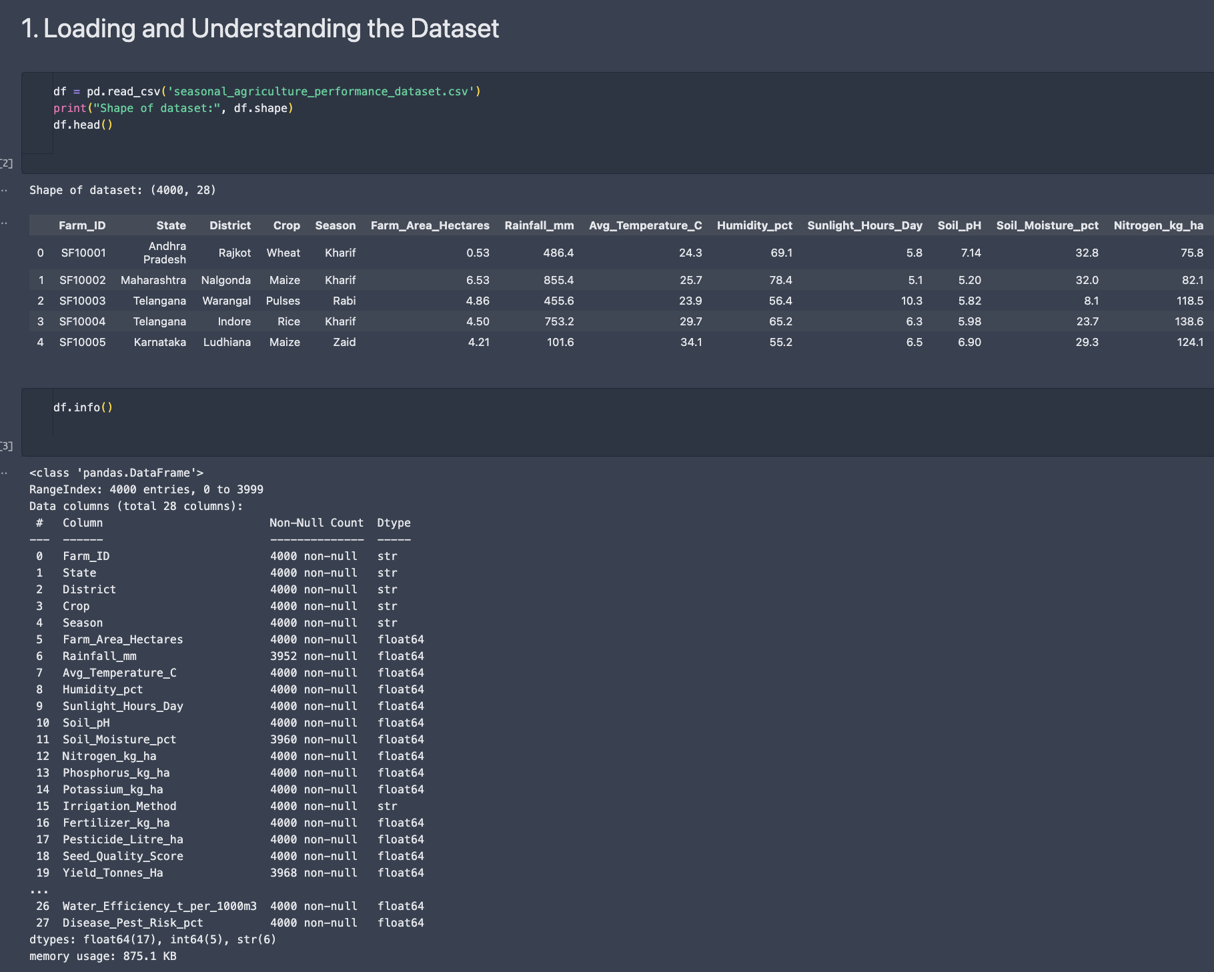
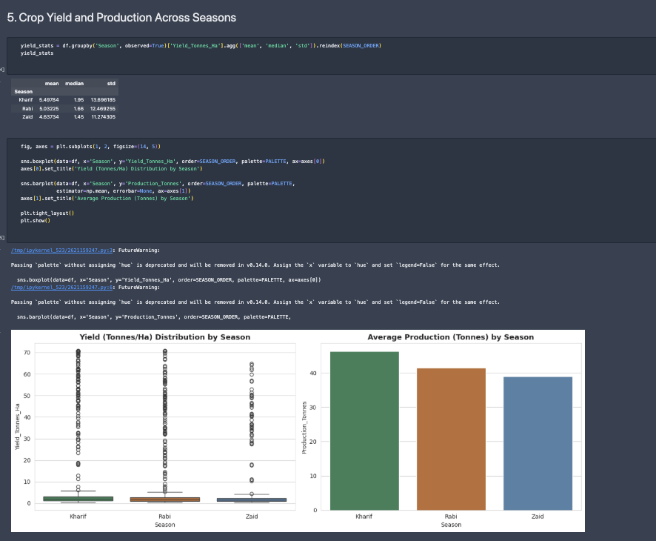
RESULTS

Slide 7
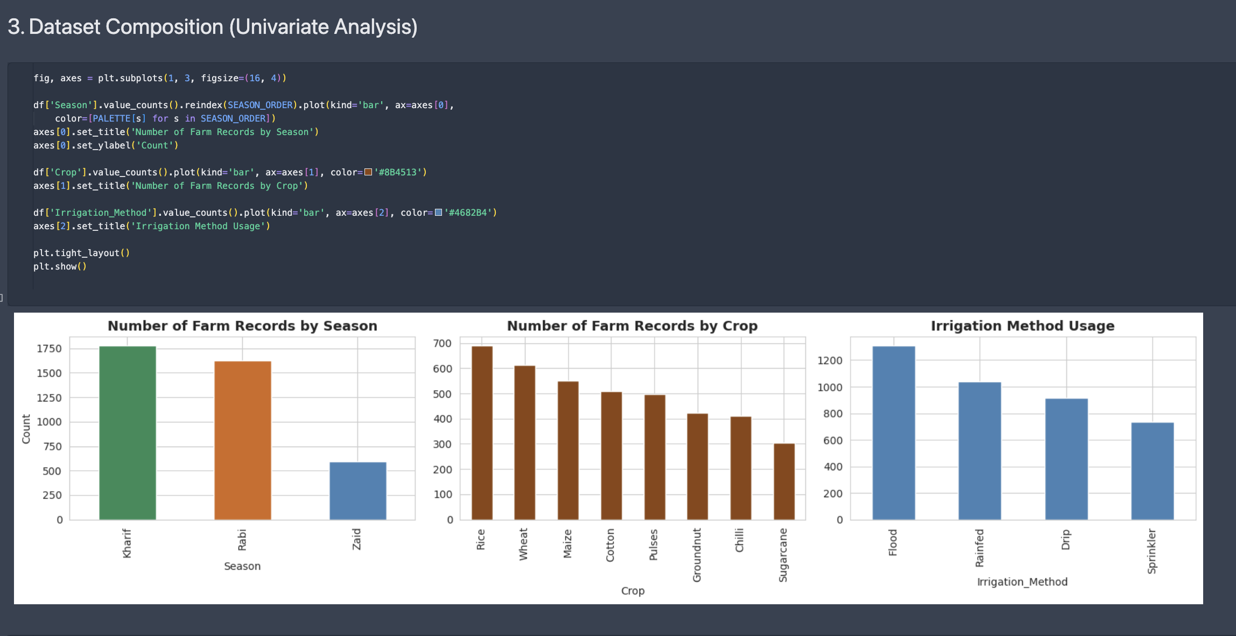
RESULTS

Slide 8
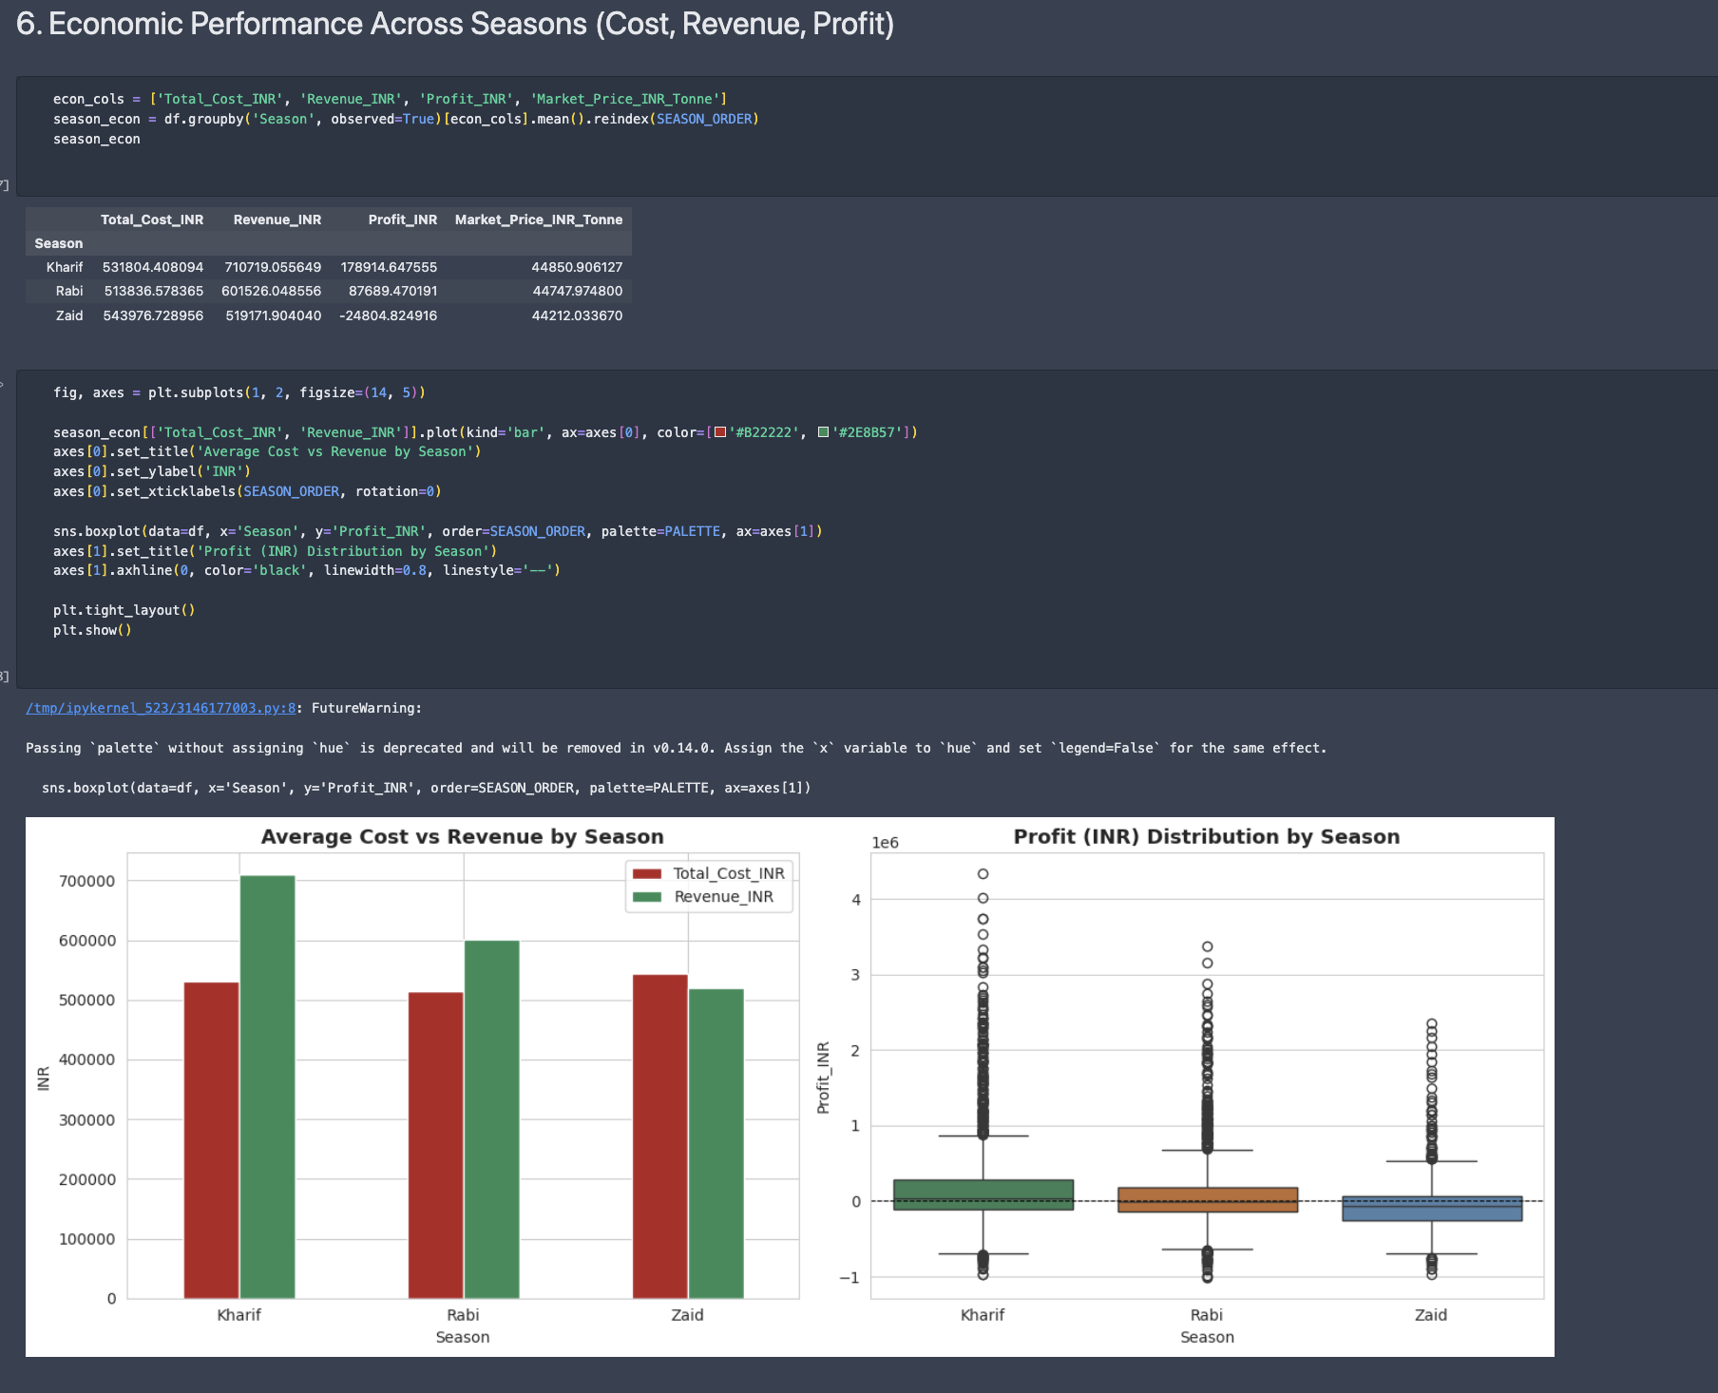
RESULTS

Slide 9

RESULTS

Slide 10
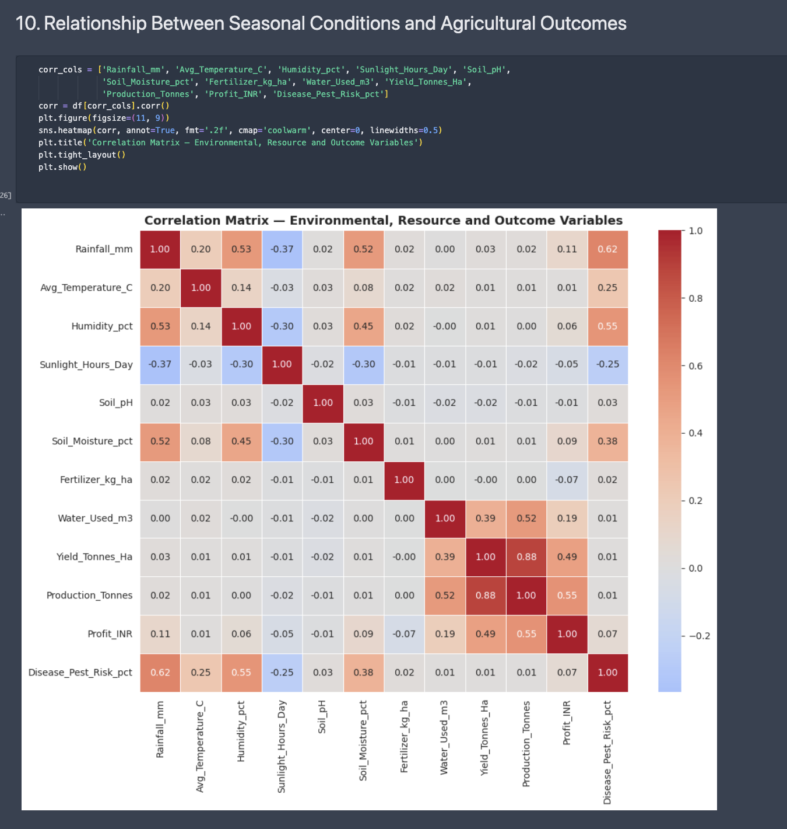
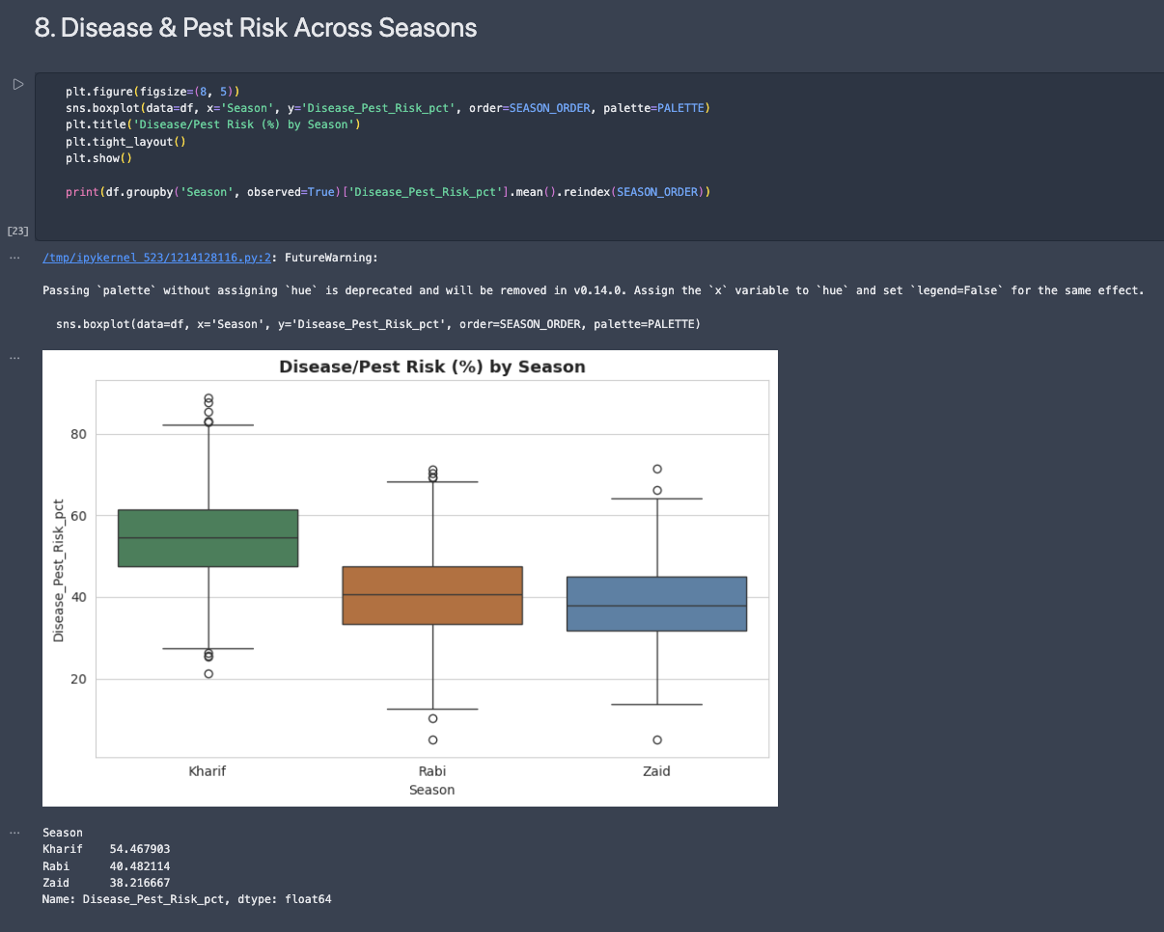
RESULTS

Slide 11
Future scope
The project can be further enhanced in the following ways:
Integrate real-time weather and climate data
Include more agricultural categories and crop types
Improve resource planning using historical seasonal data
Develop predictive models for future agricultural performance
Real-Time Agricultural Dashboard
Mobile Application integration
Smart Resource Management

Slide 12
GitHub Link
https://github.com/Poojanpatel12/Seasonal-Agriculture-Performance-Analysis

Slide 13
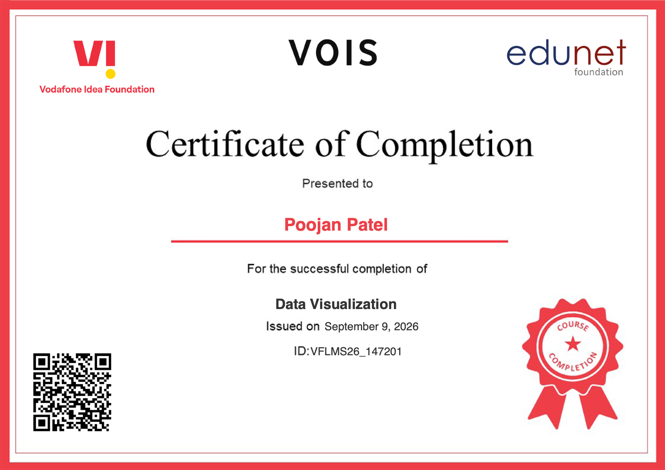
VOIS Course completion certificate -
Course name- Data Visualization

Slide 14
Thank you
.
.

